Slide 1
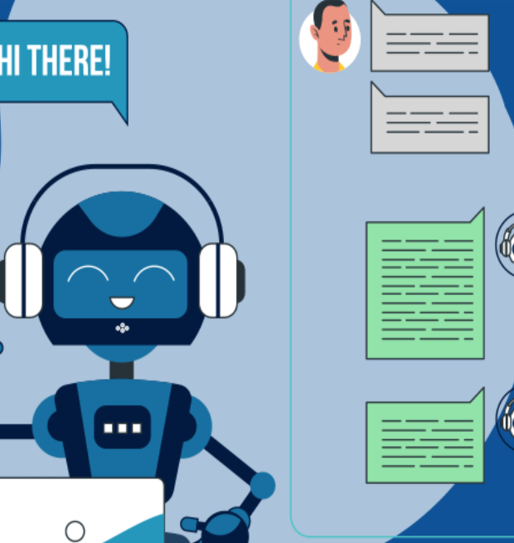
Voice Bot: A Speech Recognition and NLP-Based Assistant
Presented By: Anshul Anand

Slide 2

Agenda
Introduction to Voice Bots
Role of Data Science in Voice Bots
Key Components of a Voice Bot
Machine Learning in Voice Bots
Use Cases & Applications
Challenges in Building Voice Bots
Conclusion

Slide 3

What are Voice Bot Solutions?
A voice bot is an AI-powered system that interacts with users using spoken language.
Technologies Involved: - Natural Language Processing (NLP) - Automatic Speech Recognition (ASR) - Text-to-Speech (TTS)
Purpose: Enhance customer service, automate tasks, and improve user interaction.

Slide 4
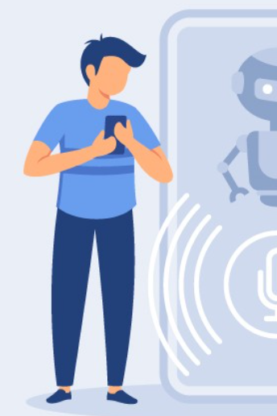
Role of Data Science in Voice Bots
Data Science: Analyzing and processing data to improve decision-making.
Key Contributions:
Natural Language Understanding (NLU): Interpreting user input.
Speech Recognition: Converting spoken language into text.
Personalization: Adapting bot responses based on user behavior.
Training Models: Creating intelligent models that improve over time with more data.

Slide 5
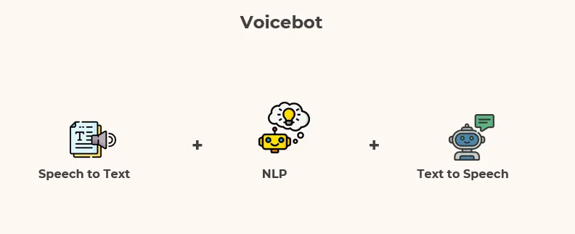
Key Components of a Voice Bot
Speech Recognition (ASR): Converts spoken language into text. Models used: Deep neural networks, HMMs (Hidden Markov Models).
Natural Language Processing (NLP):
Analyzes text for intent, entities, and sentiment. Includes tasks like tokenization, named entity recognition (NER), and dependency parsing.
Text-to-Speech (TTS):
Converts text into natural-sounding speech. Uses deep learning models to synthesize human-like voices.

Slide 6
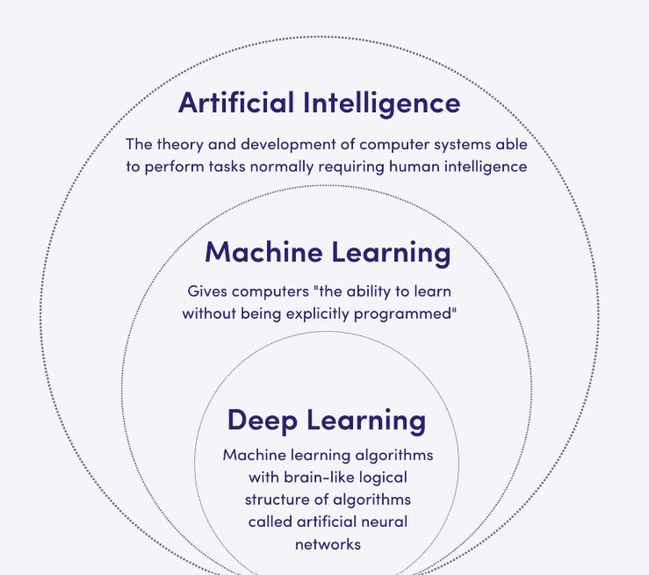
Machine Learning in Voice Bots
Supervised Learning:
Training models on labeled data (e.g., matching text with user intents).
Unsupervised Learning:
Detecting patterns in speech or conversation without labeled data.
Reinforcement Learning:
Continuous improvement based on user interaction and feedback.
Deep Learning:
Leveraging neural networks for complex tasks like voice synthesis and speech recognition.

Slide 7

Use Cases and Applications
Customer Support: Automating customer service tasks (e.g., handling FAQs, troubleshooting).
Virtual Assistants: Google Assistant, Alexa, Siri.
Healthcare: Voice bots for scheduling appointments or answering medical questions.
E-commerce: Assisting customers in shopping, product discovery, and order tracking.
Smart Homes: Controlling IoT devices through voice commands.

Slide 8

Challenges in Building Voice Bots
Speech Recognition Accuracy: Accents, noise, and voice quality can affect ASR accuracy.
Contextual Understanding: Understanding context in dynamic conversations.
Data Privacy & Security: Protecting sensitive user data while maintaining functionality.
Handling Ambiguity: Disambiguating vague user input and providing clear responses.
Multilingual Support: Handling multiple languages and dialects.

Slide 9

Conclusion
Summary: Voice bots powered by data science are transforming customer experiences and operational efficiency.
Future Outlook: As AI and NLP technologies advance, voice bots will continue to become smarter and more intuitive.
Call to Action: Explore how data science can drive innovation in voice-based systems in your organization.

Slide 10


